Slide 1



X
Kimia Farma
Performance Analytics
Business Performance 2020-2023
Presented by
Dinda Laura Putri Permadi

Slide 2










Dinda Laura Putri Permadi
Mathematics Graduate | Aspiring Data Analyst
Mathematics graduate with a strong analytical background and practical experience in data analytics training and projects. Skilled in Python, SQL, Excel, Power BI, and Looker Studio, with a focus on analyzing data, identifying trends, and translating findings into actionable business insights.
Bachelor of Mathematics - 2026
Universitas Sebelas Maret (GPA 3.64/4.00)
Yogyakarta, Indonesia
Data Analytics and Generative AI Program - 2024
Dindalaura42@gmail.com
RevoU Tech Academy | MSIB Batch 7
Dinda Laura Putri Permadi
Technical Tools |

Slide 3




Courses and Certification
Data Analytics and Gen AI | View Certificate 2024
RevoU Tech Academy (MSIB Batch 7)
Final Score: 96/100
Data Science Foundation | View Certificate 2024
Great Learning
Belajar Dasar Visualisasi Data | View Certificate 2024
Dicoding Indonesia
Data Science Fundamentals | View Certificate 2024
DQLab
Bootcamp Data Analyst with Excel | View Certificate 2023
DQLab

Slide 4

About Company
PT Kimia Farma Tbk is an Indonesian pharmaceutical and healthcare company engaged in pharmaceutical manufacturing, distribution, retail, and healthcare services. As part of the Bio Farma Group, the company operates an extensive healthcare network across Indonesia.
Vision
To become the preferred integrated healthcare company that creates sustainable value.
Mission
To develop businesses across the pharmaceutical industry, distribution, retail, and healthcare services.
To uphold good corporate governance and operational excellence through professional human resources.
To create added value and benefits for all stakeholders.

Slide 5
Project Portfolio
This project analyzes Kimia Farma’s business performance from 2020 to 2023 using four datasets covering transactions, inventory, branches, and products. The datasets were consolidated in BigQuery and visualized in Looker Studio to assess annual sales trends, estimated net profit, provincial contributions, and customer ratings.
Problem Statement.
How effectively did Kimia Farma perform across sales, estimated profitability, and customer experience from 2020 to 2023, and what performance gaps and improvement opportunities can be identified across its provinces and branches?
Project Documentation:
Explore on GitHub

Slide 6
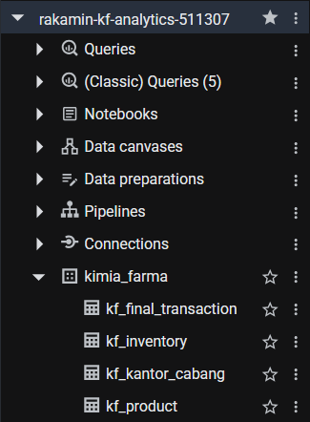
Importing Dataset to BigQuery
The four CSV files provided by Kimia Farma were uploaded to Google BigQuery. This process involved three main steps:
Creating the BigQuery Project
The project was named rakamin-kf-analytics-511307 to serve as the workspace for the analysis.
Creating the Dataset
A dataset named kimia_farma was created to store the imported tables.
Creating Tables and Uploading CSV Files
Four tables were created by importing the provided CSV files. The tables are kf_final_transaction, kf_inventory, kf_kantor_cabang, and kf_product. Each table contains transaction, inventory, branch, or product data for further analysis.

Slide 7
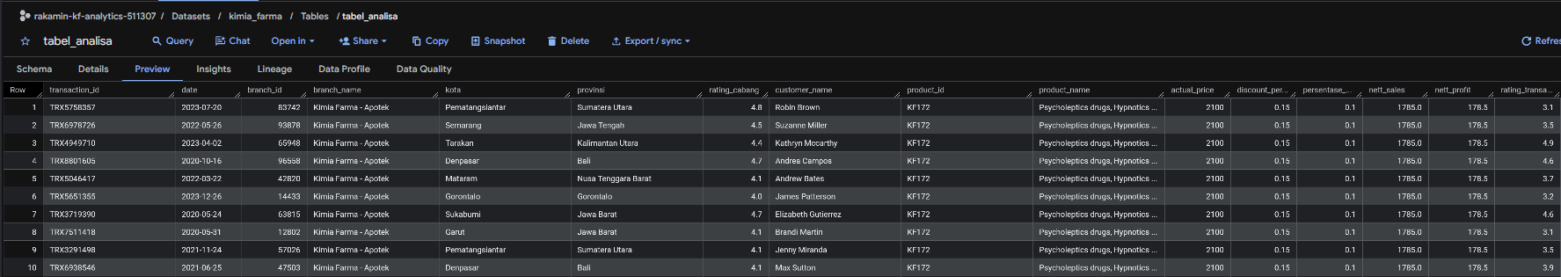
Final Analysis Table
The final analysis table, named tabel_analisa, was created in BigQuery by integrating transaction records with branch and product information. It contains key transaction details, including customer names, branch ratings, transaction ratings, and financial metrics such as net sales and net profit.

Slide 8
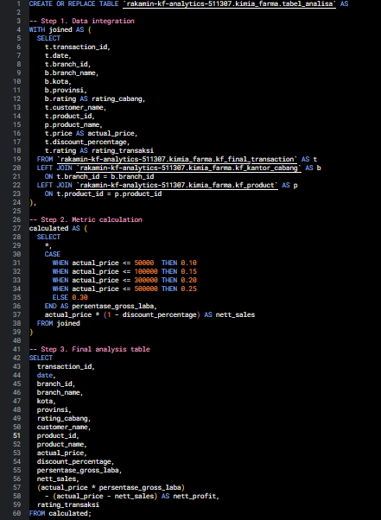
BigQuery Syntax
The SQL query uses LEFT JOIN operations to integrate transaction records with branch and product details. It applies gross profit margin rates based on actual product prices, calculates net sales after discounts, and derives estimated net profit by deducting the discount amount from the expected gross profit. The resulting analysis table provides the financial and operational metrics used for further business performance analysis.

Slide 9
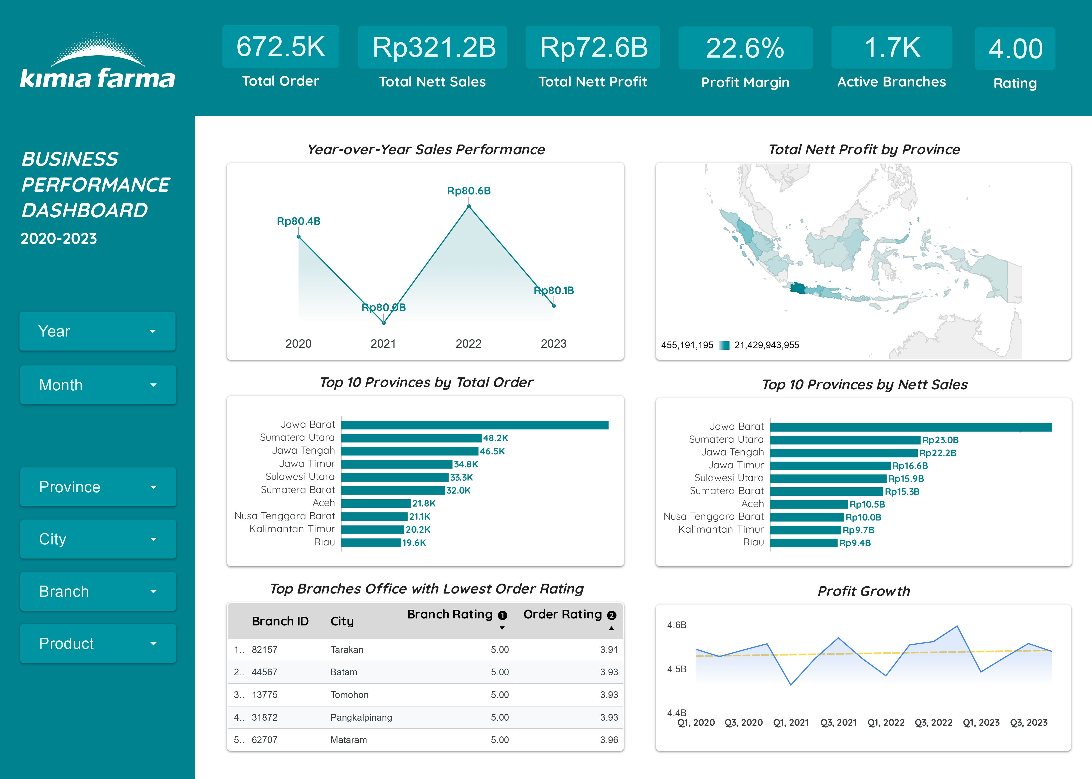
Dashboard Performance Analytics
The dashboard summarizes Kimia Farma’s business performance from 2020 to 2023, covering sales, estimated profitability, provincial contributions, and customer ratings. Key metrics include Rp321.17B in net sales, Rp72.56B in estimated net profit, and an estimated profit margin of 22.6%. Interactive filters enable performance comparisons across reporting periods and regions.
Interactive Dashboard:
Explore on Looker Studio

Slide 10
Insights
No. | Insights
1 | Stagnant Sales Growth. Annual net sales remained stable at approximately Rp80B, with YoY growth ranging from -0.57% to +0.68%
2 | Quarterly Profit Fluctuations. Q1 recorded the lowest quarterly estimated profit in 2021–2023, indicating recurring quarterly fluctuations
3 | Provincial Sales Concentration. Jawa Barat contributed 29.54% of net sales, followed by Sumatera Utara and Jawa Tengah. The top three provinces accounted for 43.62%
4 | Customer Rating Discrepancies. 96 branches with perfect ratings (5.00) recorded transaction ratings below 4.00

Slide 11
Business Recommendations
No. | Business Recommendation
1 | Strengthen Sales Performance. Implement targeted promotions, product bundles, and loyalty programs to support sustainable sales growth
2 | Optimize Quarterly Profitability. Review Q1 demand, discount patterns, and inventory allocation to improve quarterly profitability
3 | Expand Regional Market Opportunities. Strengthen leading markets while pursuing targeted growth opportunities across other provinces
4 | Improve Customer Experience. Investigate rating discrepancies and strengthen service standards, staff training, and complaint resolution

Slide 12
Thank You
X

